Slide 1



Weather vs Crime - Chicago
Cloudy With A Chance Of Arson
Liam Brekke
Justin Laka
Kristen Lega
Arianna Rocchi
Nicole Sommerfeld

Slide 2


Data Sources

Slide 3
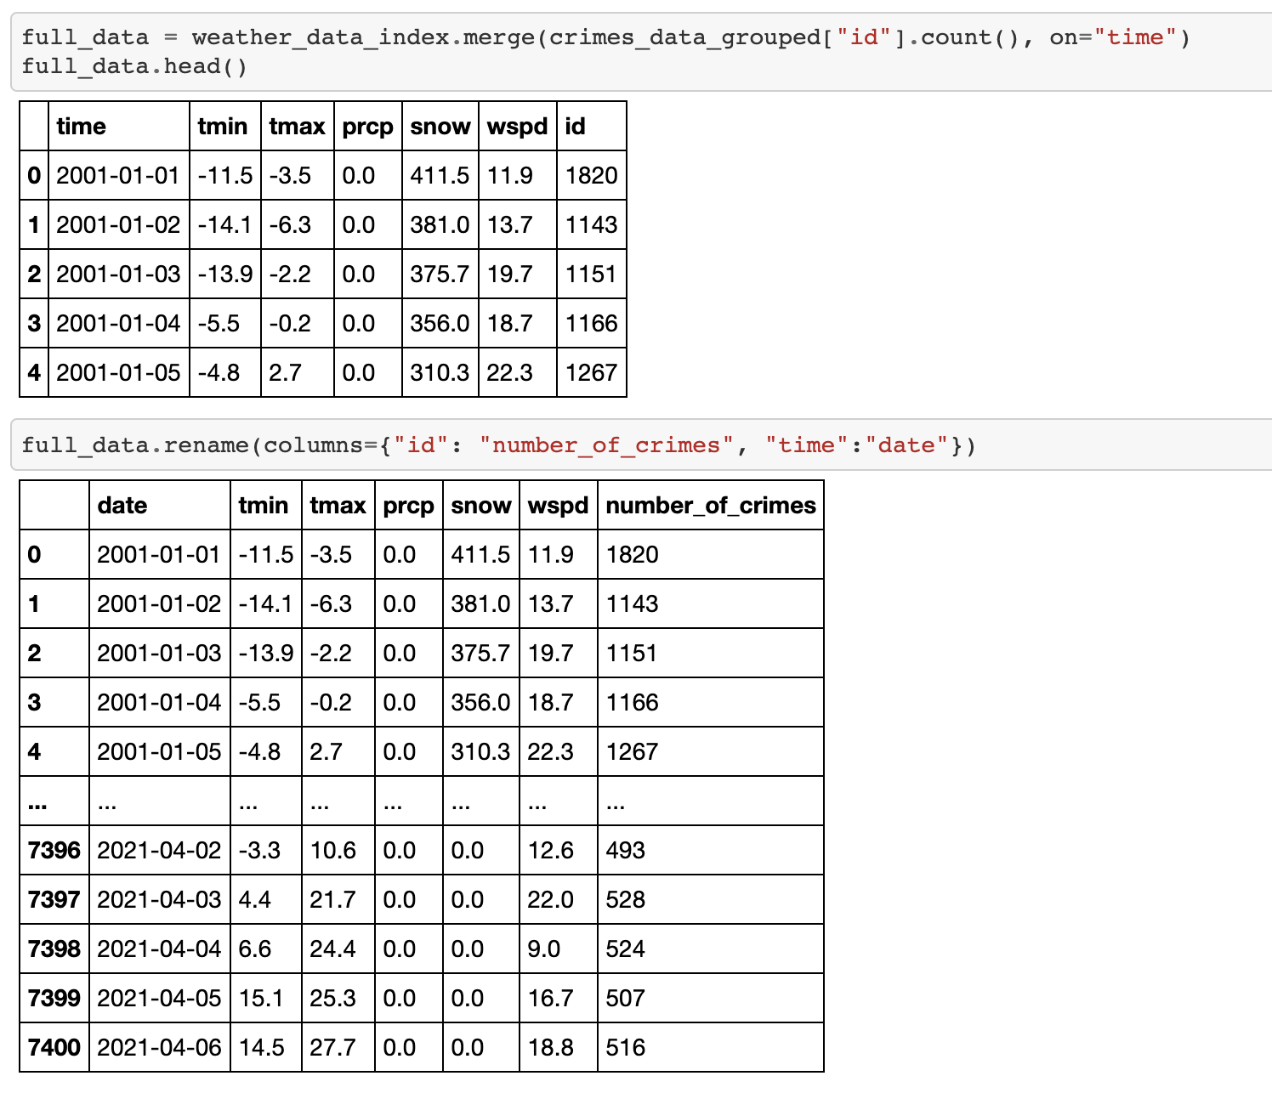
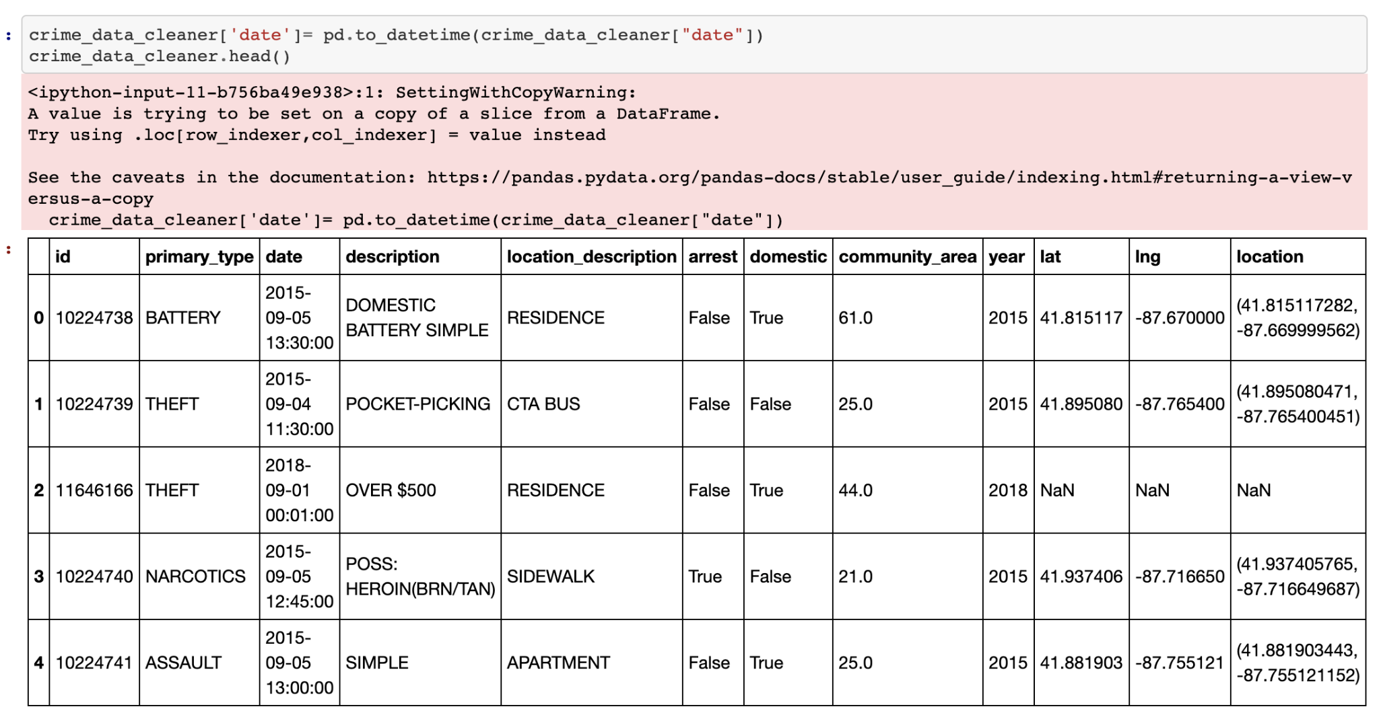
Data Cleaning
Data Joining

Slide 4
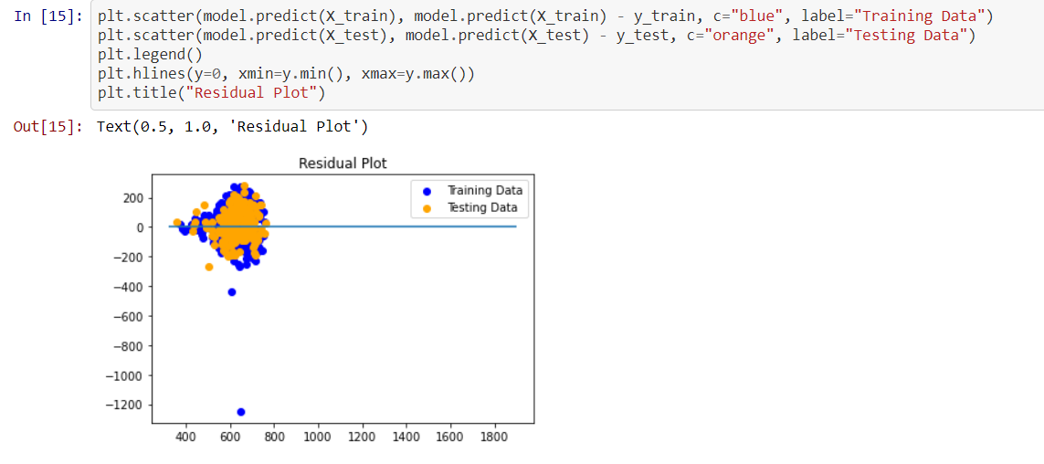
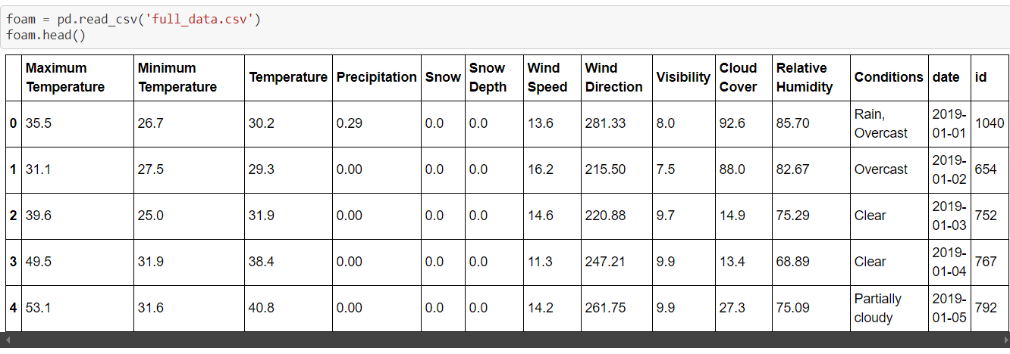
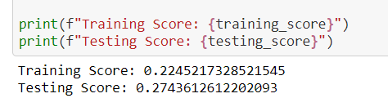
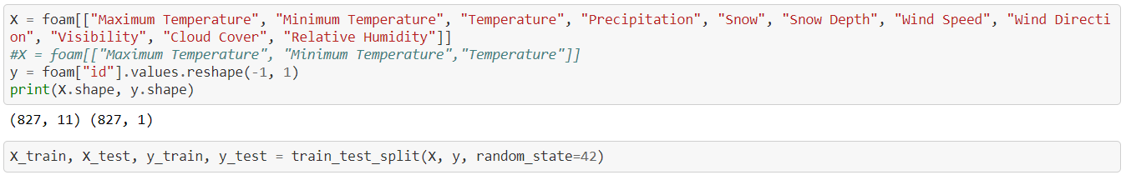
Initial ML Model
Notes:
Initial ML.
We ran this basically as a test to see if our data was working, accurate. Only 2.5 yr of data rather than what we pivoted to work with.
Ran some initial testing with SK Learn, Matplotlib with our first data passes.
Pulled in several since-cleaned predictors (X), e.g. :
"Snow Depth", "Wind Direction", "Visibility", "Cloud Cover", "Relative Humidity"
Response variable y = ID (crimes)
Model.fit after test train split, test data scored 27%
Amt of variables, maybe even units of measurement,
Really was a quick and dirty version of our next model, which Justin will speak about.

Slide 5
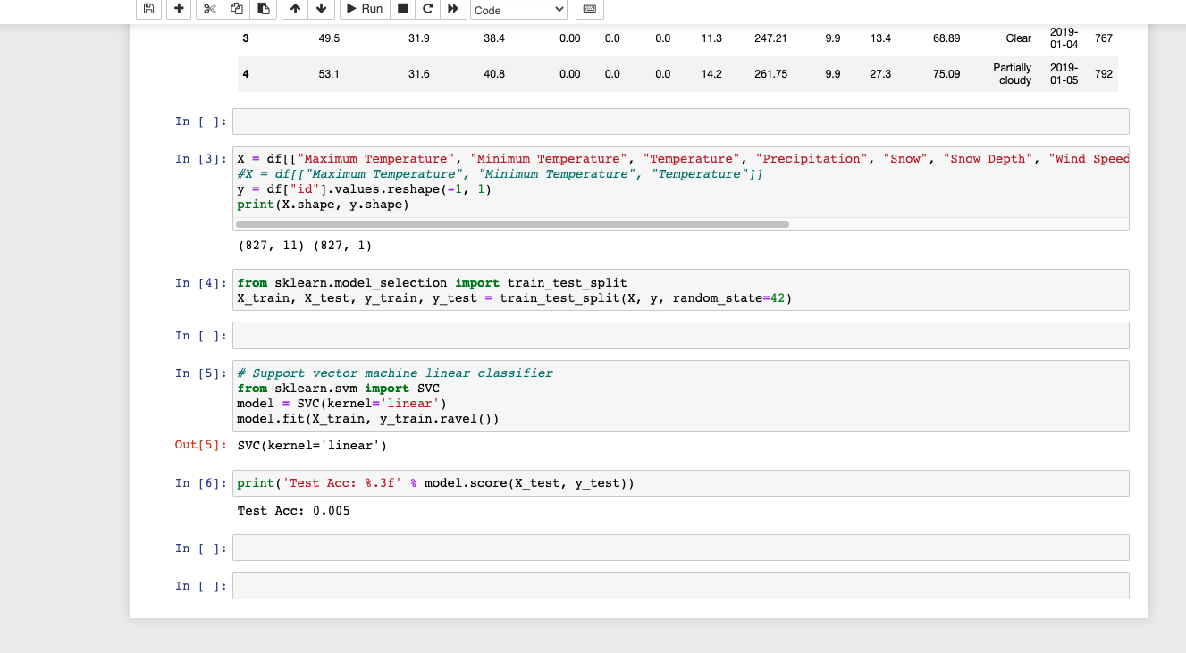
Additional Data Needs

Slide 6
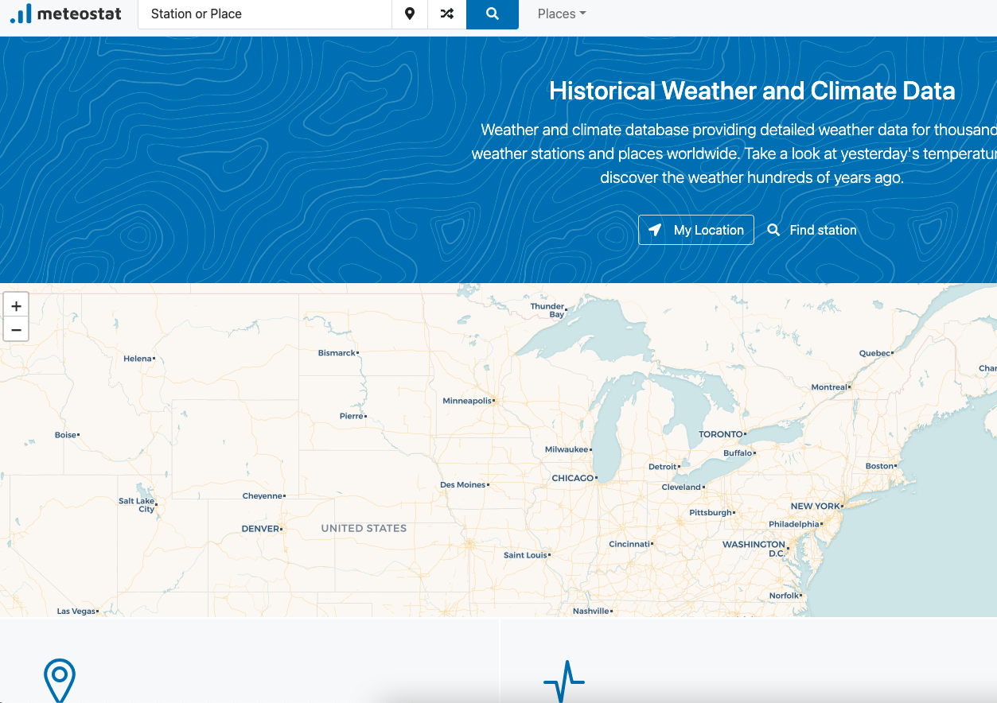
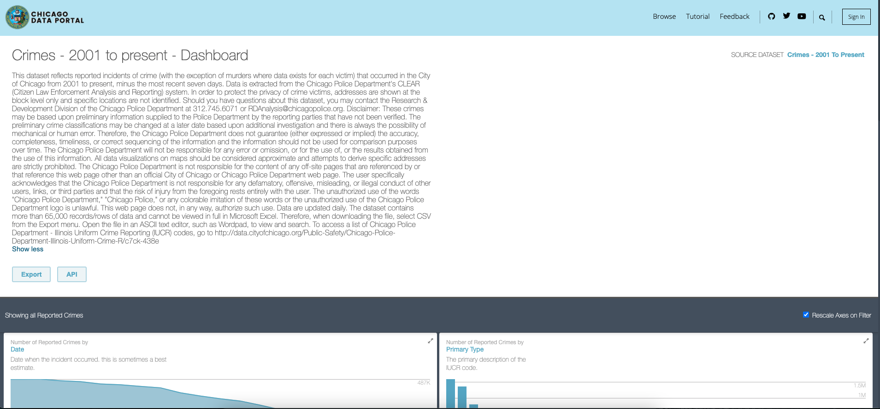
Additional Data Needs

Slide 7
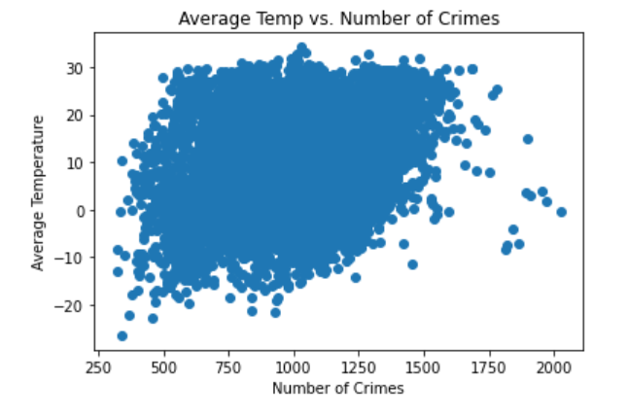
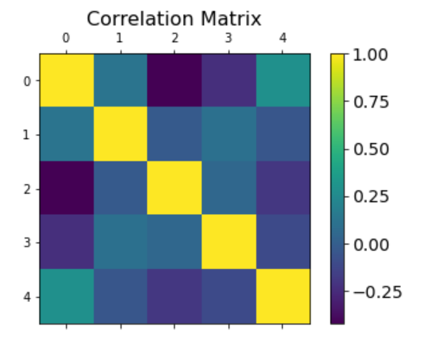
Matplotlib

Slide 8
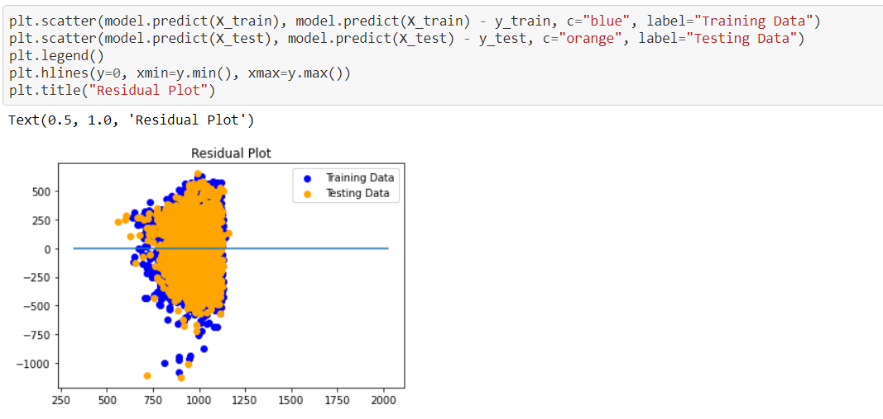
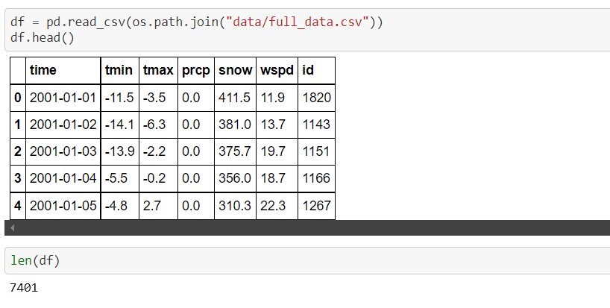
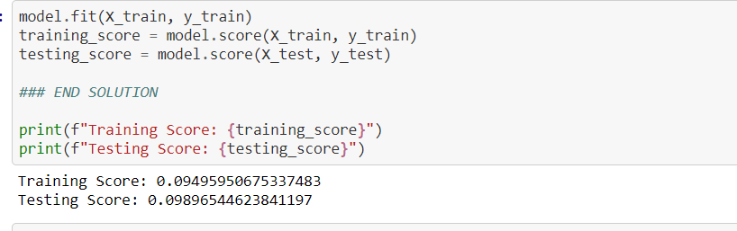
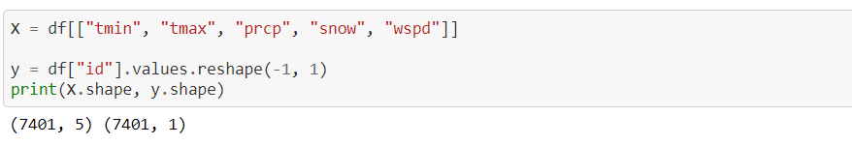
New Linear Regression

Slide 9
Heroku/App Deployment
Created a flask app with a template html file.
User enters data and submits POST
Used two methods for predicting crime: Coefficient formula and Model
#load the machine learning model
model = joblib.load('Model.sav')
#put input into an array for model
new_input2 = [[x_tmin, x_tmax, x_prcp, x_snow, x_wspd]]
#calculate estimate based on coefficients and intercept
new_output = 2.61*x_tmin + 3.91*x_tmax - 2.14*x_prcp - 0.40*x_snow - 1.63*x_wspd + 944.59
#calculate estimate based on model
new_output2 = model.predict(new_input2)
Pushed all app files to Heroku for web deployment with requirements.txt and Procfile

Slide 10

Thank You!!!

